Slide 1
CLup project
Notes:
Good morning, now we will present our clup project

Slide 2
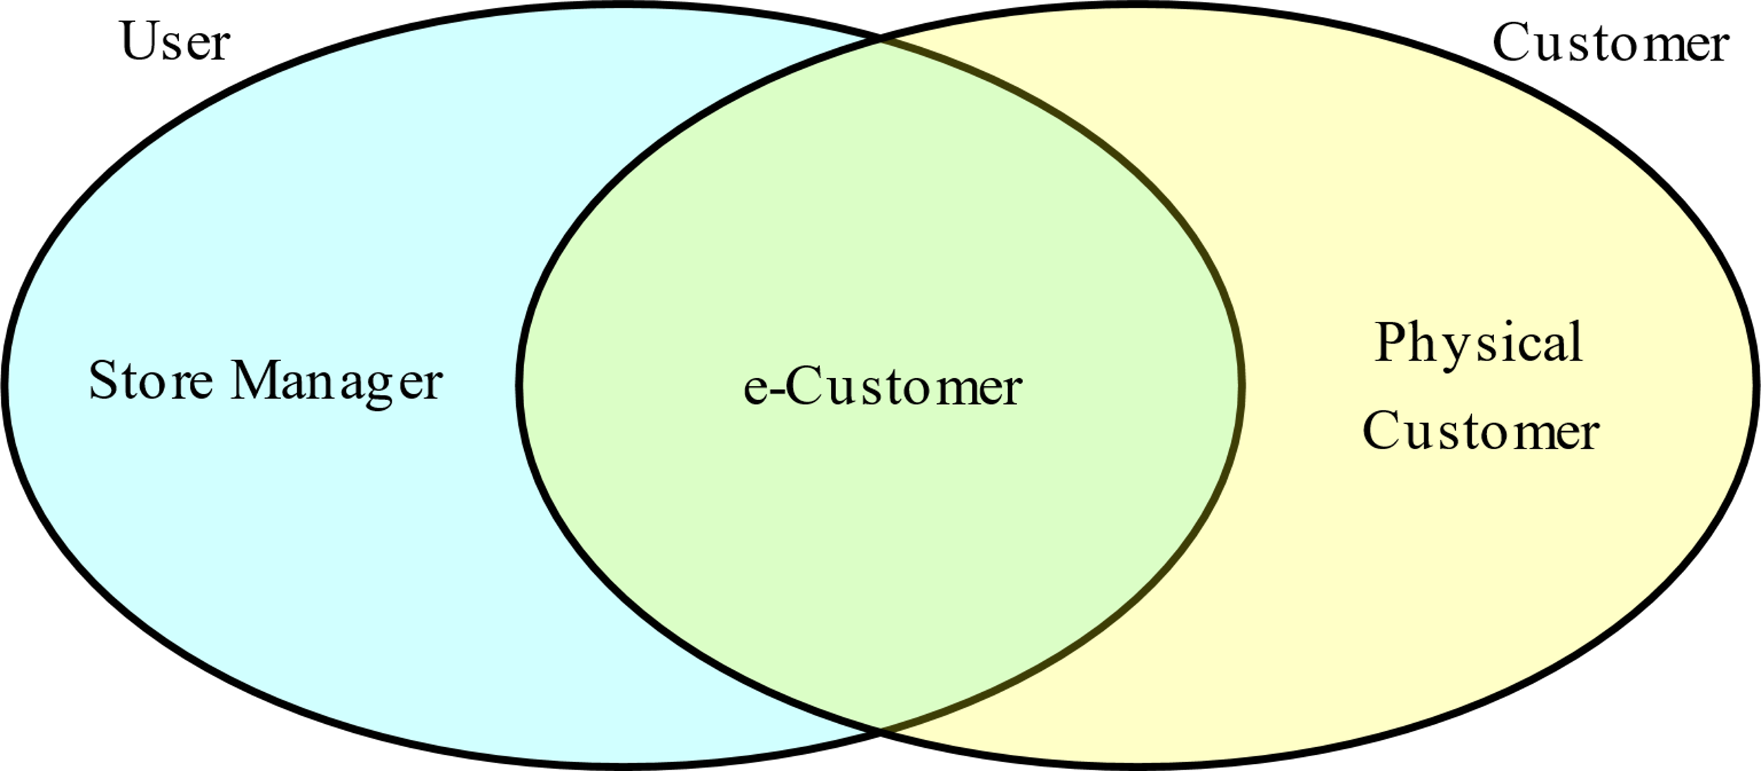
Actors
Prospective e-Customer: A person who would like to use the application as customer
Prospective Store Manager: A person who would like to register their store
Physical Customer: A customer not registered to the application
e-Customer: A customer using the application
Store Manager: A user managing a store
Notes:
First things first, we want to introduce the actors involved in the application. While store manager and e-customer belongs to the user base, we account for physical customer as customer that will use the fallback options available at shops.

Slide 3
Goals
G0
G2
G3
G4
G5
G6
G7
Allow prospective e-Customers to register to the application
G5.1
G1
Allow Prospective Store Managers to register to the application by adding their store
G4.1
G2.1
Allow e-Customers to line up from home
Allow e-Customers to dequeue
Allow Store Managers to monitor entrances
Allow Physical Customers to line up
Allow Physical Customers to dequeue
Allow e-Customers to book a visit
Allow e-Customers to delete a visit
Suggest alternative slots to balance the number of customers
Allow e-Customers to manage slot notifications
Notes:
Our application’s goals aside from users registration are aimed at allowing e-customers to manage tickets and notifications and to book visits, and store managers to monitor entrances and to check that the maximum capacity is not exceeded while still providing fallback options.

Slide 4
A use case: e-Customer Lines Up
Actors | e-Customer
Goals | [G2]
Input conditions | e-Customer is already logged in and wants to enqueue
Events flow | The e-Customer clicks on the "New ticket" button to access the section The e-Customer inserts current location and mean of transport The app searches for available stores and shows them to the e-Customer The e-Customer chooses a store and presses "generate" The system enqueues the e-Customer for their desired store and generates a QR code for entrance
Output conditions | The process is concluded correctly and the QR code is saved on the device, under tickets
Exceptions | No stores are available for the defined parameters Handled by showing an error pop-up asking to check the parameters or try again later Selection becomes unavailable during the selection Handled with an error message
Notes:
We now want to illustrate the use case for the e-customer line up, one of the core functionalities of the application

Slide 5
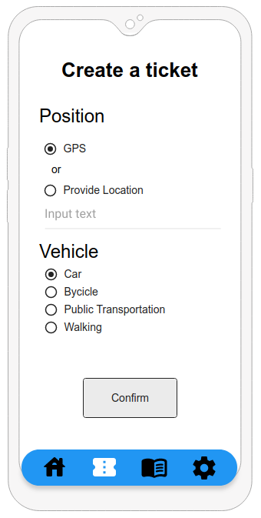
A use case: e-Customer Lines Up
Actors | e-Customer
Goals | [G2]
Input conditions | e-Customer is already logged in and wants to enqueue
Events flow | The e-Customer clicks on the "New ticket" button to access the section The e-Customer inserts current location and mean of transport The app searches for available stores and shows them to the e-Customer The e-Customer chooses a store and presses "generate" The system enqueues the e-Customer for their desired store and generates a QR code for entrance
Output conditions | The process is concluded correctly and the QR code is saved on the device, under tickets
Exceptions | No stores are available for the defined parameters Handled by showing an error pop-up asking to check the parameters or try again later Selection becomes unavailable during the selection Handled with an error message
Notes:
The e-Customer has to insert its location either by GPS or typing and to select the vehicle

Slide 6
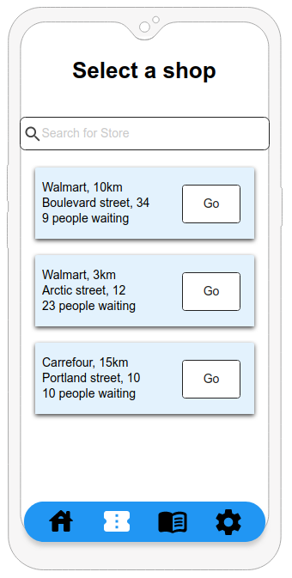
A use case: e-Customer Lines Up
Actors | e-Customer
Goals | [G2]
Input conditions | e-Customer is already logged in and wants to enqueue
Events flow | The e-Customer clicks on the "New ticket" button to access the section The e-Customer inserts current location and mean of transport The app searches for available stores and shows them to the e-Customer The e-Customer chooses a store and presses "generate" The system enqueues the e-Customer for their desired store and generates a QR code for entrance
Output conditions | The process is concluded correctly and the QR code is saved on the device, under tickets
Exceptions | No stores are available for the defined parameters Handled by showing an error pop-up asking to check the parameters or try again later Selection becomes unavailable during the selection Handled with an error message
Notes:
Then the e-customer can choose one store among the suggested ones

Slide 7
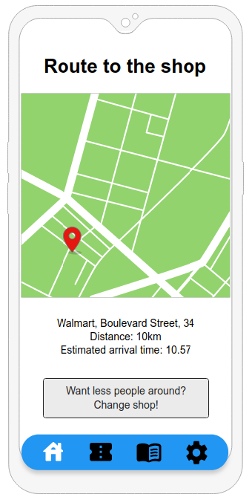
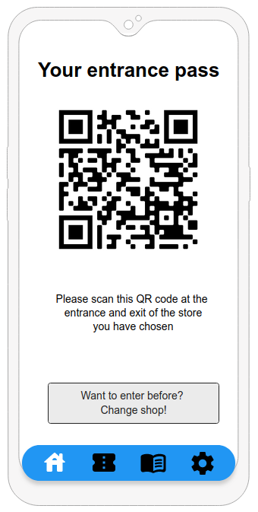
A use case: e-Customer Lines Up
Actors | e-Customer
Goals | [G2]
Input conditions | e-Customer is already logged in and wants to enqueue
Events flow | The e-Customer clicks on the "New ticket" button to access the section The e-Customer inserts current location and mean of transport The app searches for available stores and shows them to the e-Customer The e-Customer chooses a store and presses "generate" The system enqueues the e-Customer for their desired store and generates a QR code for entrance
Output conditions | The process is concluded correctly and the QR code is saved on the device, under tickets
Exceptions | No stores are available for the defined parameters Handled by showing an error pop-up asking to check the parameters or try again later Selection becomes unavailable during the selection Handled with an error message
Notes:
And at the end of the process he/she can access route towards the shop and the QR code to be scanned at shop’s entrance

Slide 8
Requirements
[R11] Must allow a delay of at most M minutes on a customer’s turn
[R14] At least P% places must be reserved for tickets
[R17.1] Must allow scanning QR codes on entrance and exit
[R26] Alternatives must be based on information provided by the e-Customer and store occupation (both real time and historical)
Notes:
These are some particular requirements found for the application.
We allow sm to set some parameters such as the max delay on an entrance and the minimum number of places reserved for tickets in order to avoid that reservations take all the places
QR codes are scanned on entrance and exit to better know the flow and store historical data
Since e-Customer has to choose a shop, when the eC wants to change, the alternatives must be based on occupation

Slide 9
Domain assumptions
Customers respect the application:
[D2] Information provided by e-customers corresponds to their will
[D4] Customers enter only if allowed by the application
The infrastructure works:
[D10] Ticket printers and QR readers work properly
[D11] The internet connection is always working
[D14] The external web mapping system is always available and there is signal
Store assumptions:
[D9] If a client exits at a given time, he must have entered in the same opening period
[D13] Stores show the current customer number
Notes:
As for the domain assumptions, we identified 3 groups, first one based on the Customers behaviour that should respect their order and choices. We also assume that the infrastructure works properly. Finally, we assume that the stores respect the suggested behaviour

Slide 10
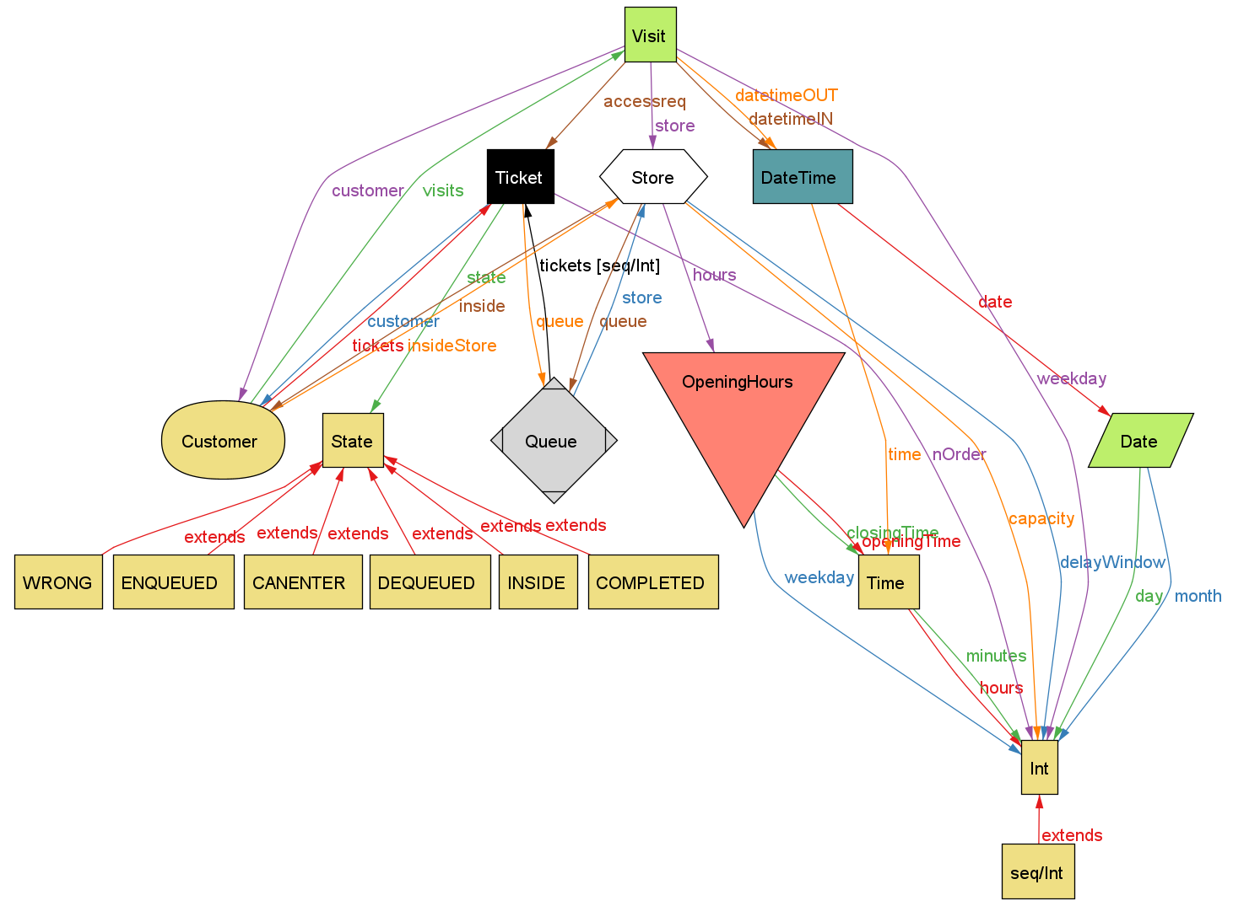
Alloy model
Notes:
In the final section of our RASD we built a model using Alloy - here we see its metamodel - focused on the states that tickets can assume during the whole process, plus the respect of opening hours of the stores, that we imposed through facts so that visits cannot occur outside of such times

Slide 11
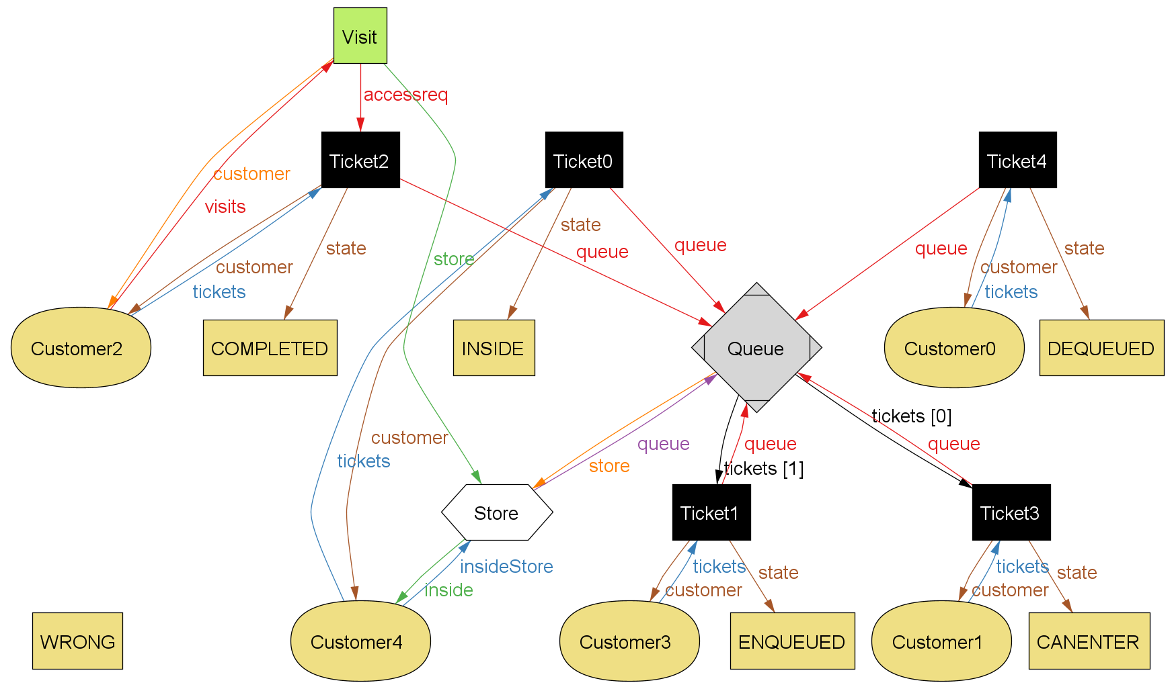
Alloy model
Notes:
This world represents the most critical part, i.e. the queue management through ticket states. For example, a complete ticket must have a visit and; the difference between an enqueued and canenter ticket is obviously tied to the store’s capacity, as both are enqueued. As we can see we used a WRONG state to check that all ticket configurations are valid.

Slide 12
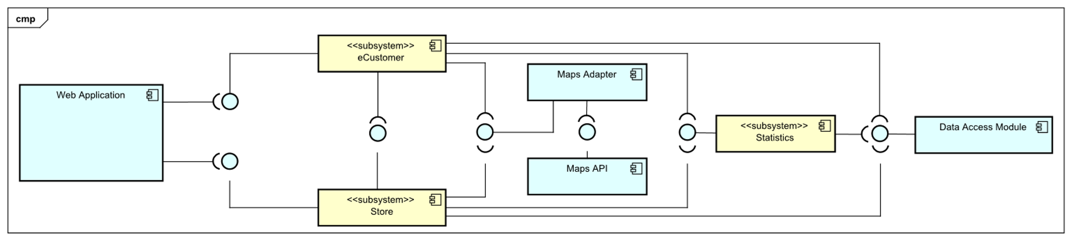
Components and interfaces
Notes:
For what concerns the DD, we have a modular application divided into 5 modules.
The maps adapter is used to communicate with the localization system api
The Data access module interfaces the application with the database
The statistics module provides historical data based on store flow and occupation

Slide 13
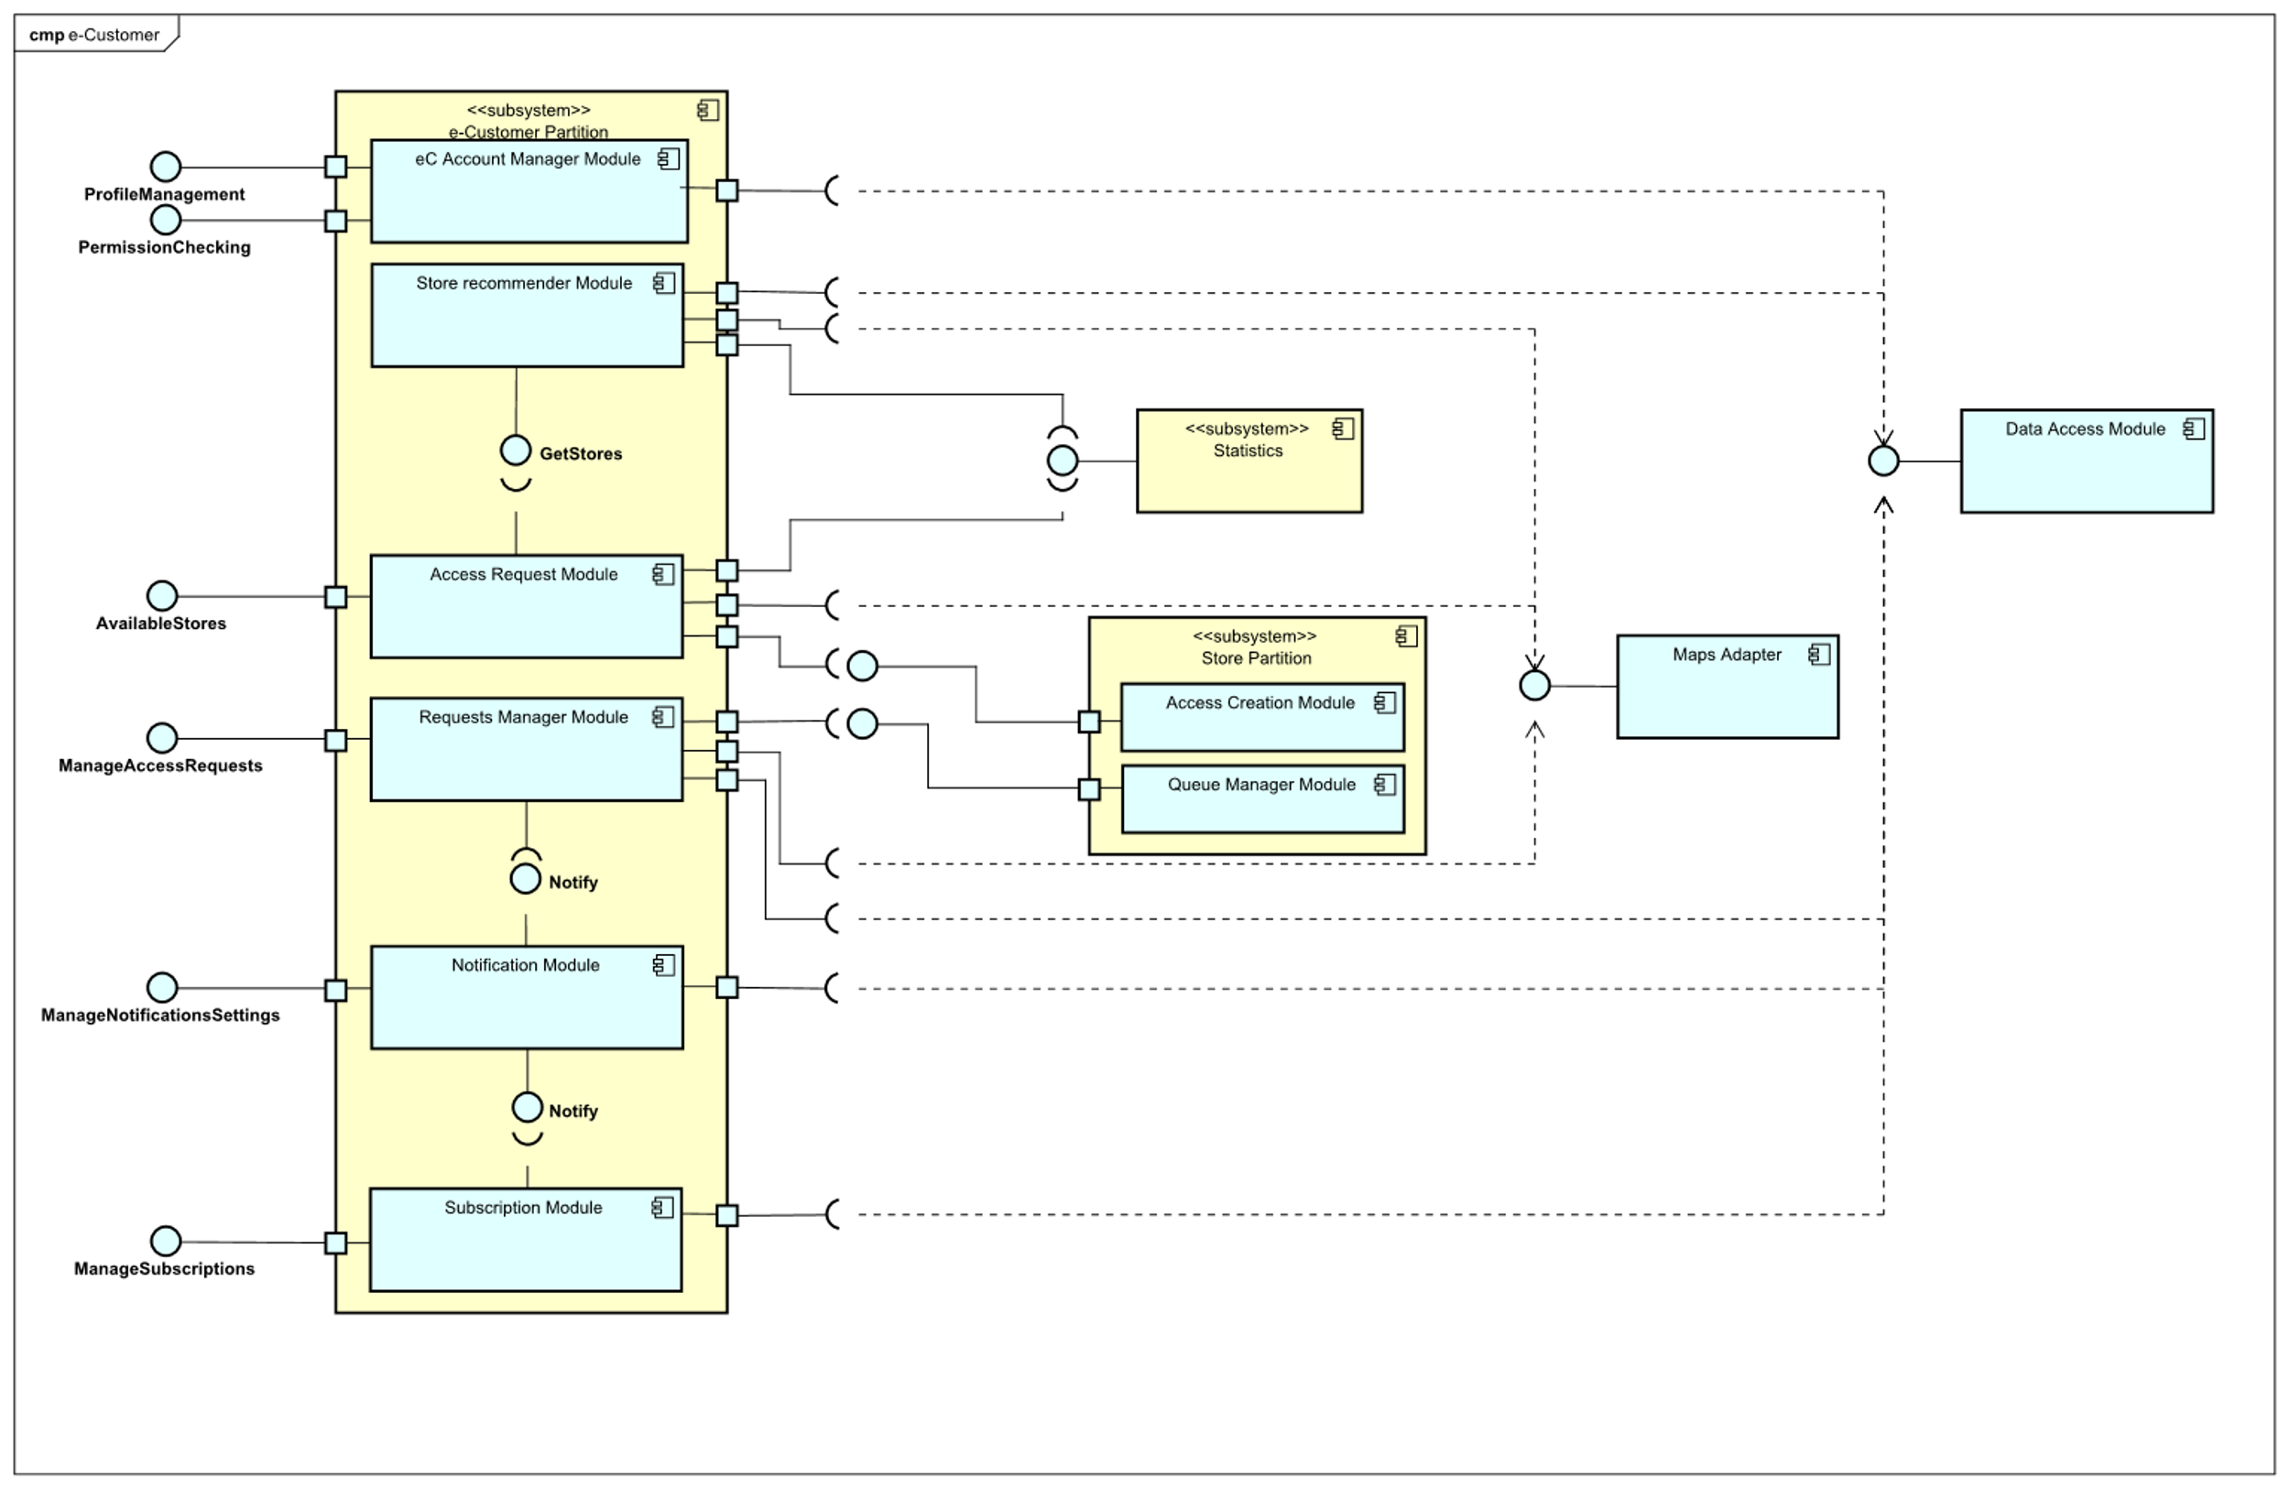
Components and interfaces
Notes:
On the e-Customer side, we have implemented components to perform registration, manage the profile and the notifications, and create tickets and reservations by receiving information about nearby stores

Slide 14
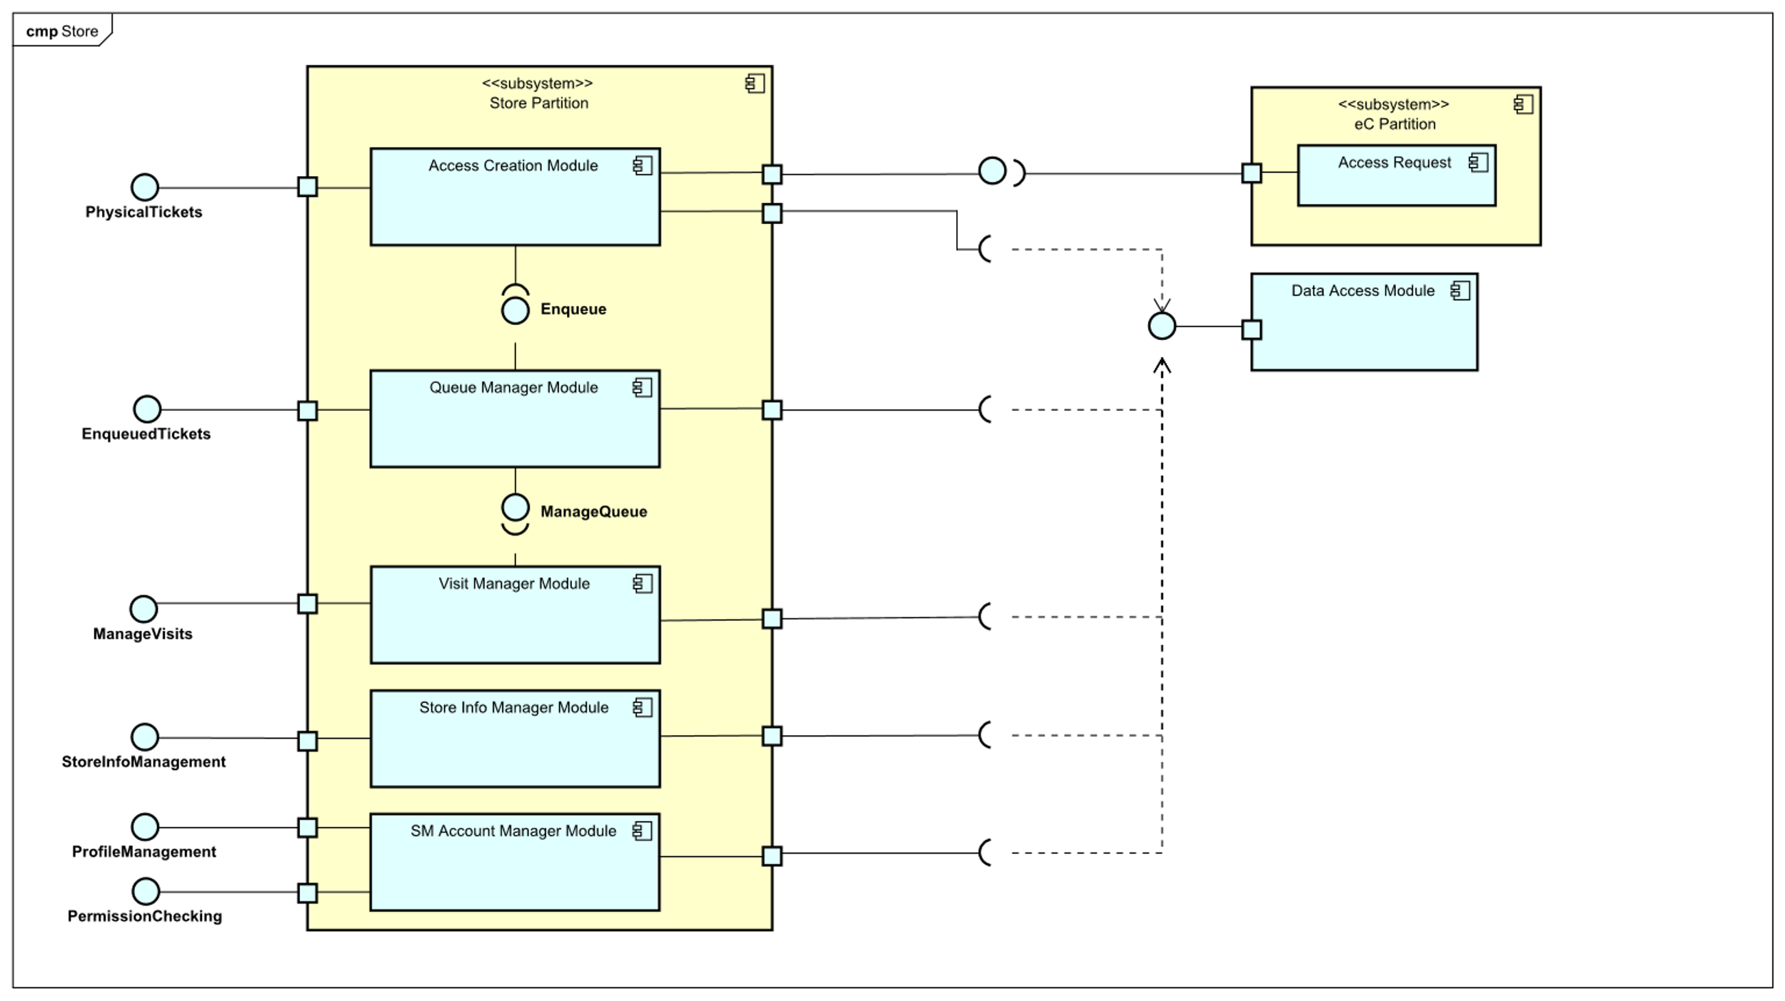
Components and interfaces
Notes:
The store manager module provides functionalities such as creating physical tickets, manage tickets and reservations, and modify the store information

Slide 15
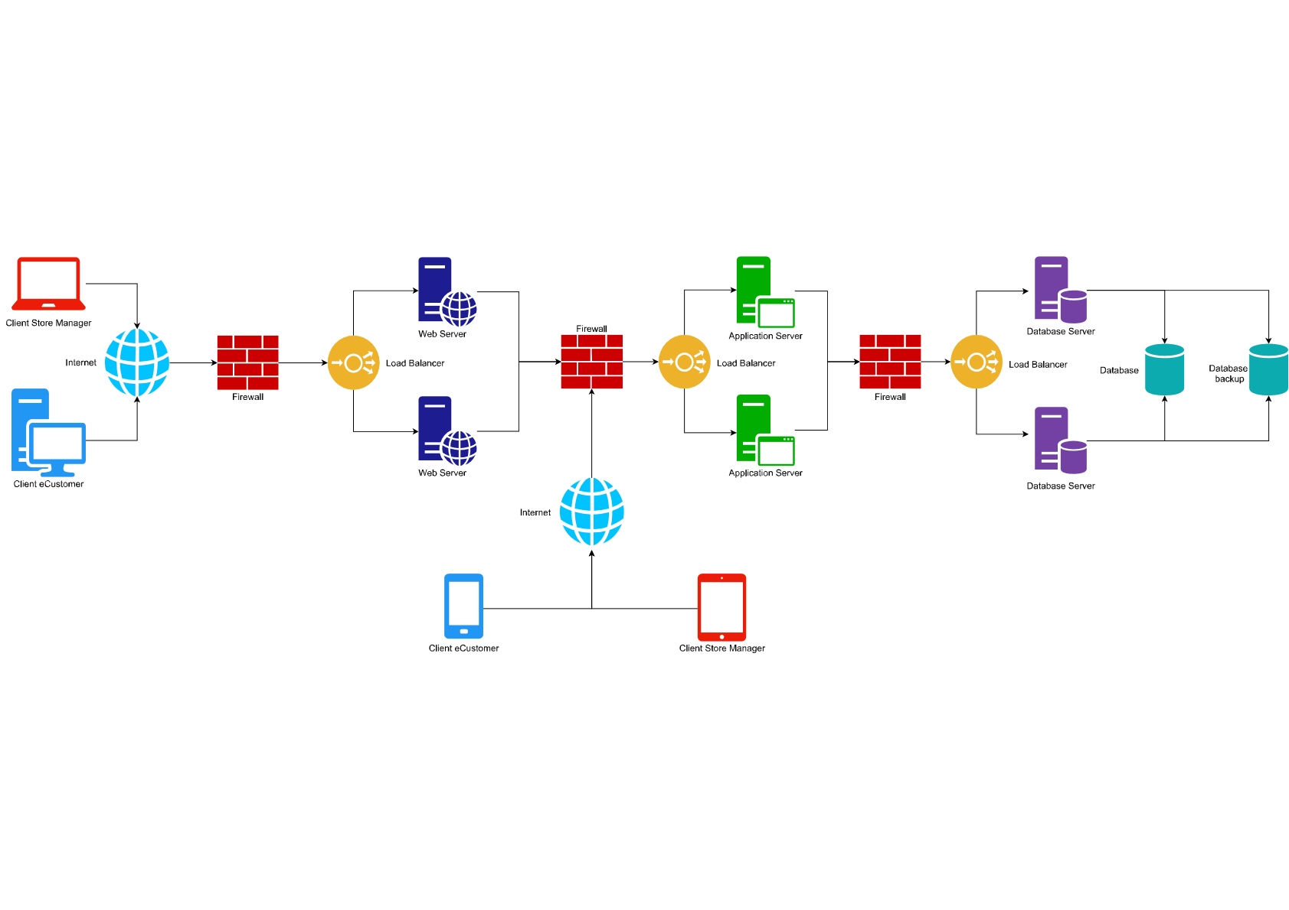
Architecture
Notes:
The architecture chosen is a client server divided into 3 logical layers (presentation, logic, data) that, for reliability and performance, are replicated on more machines

Slide 16
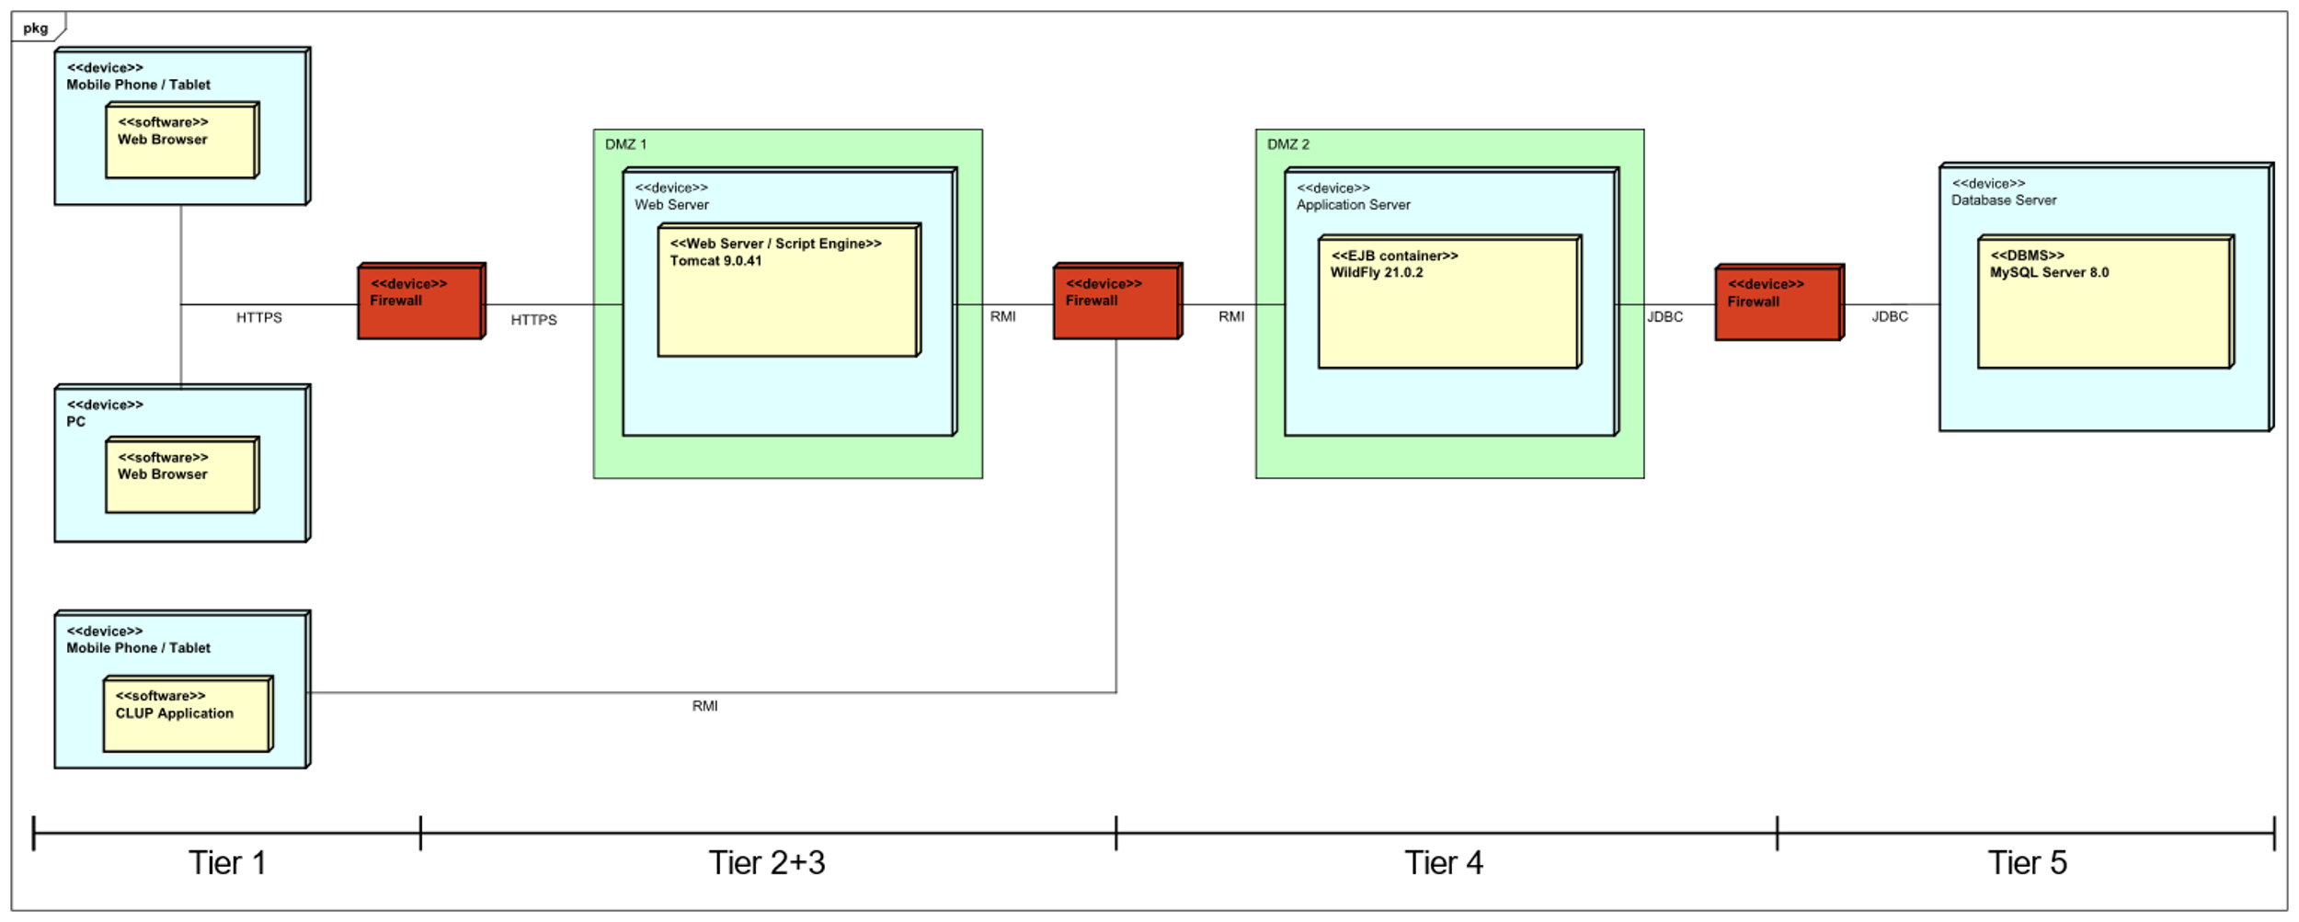
Architecture
Notes:
More in detail, we have five tiers (of which 2 and 3 are condensed into one machine through the use of tomcat that covers the functionalities of both tiers) and two dmz’s to have better security

Slide 17
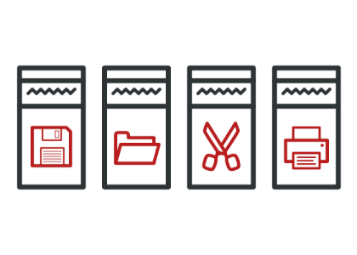


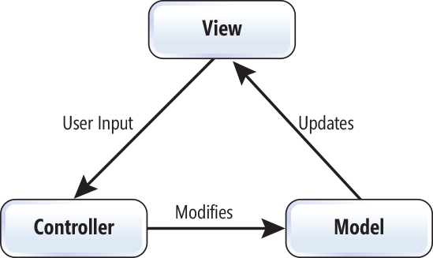

Patterns
Image credit: Refactoring Guru
Notes:
About the patterns, we decided to use MVC for the interaction with users and observer to support it; moreover, we have adapter for the apis and façade inside the statistics module. We also use command in the front end to decouple controls from code.

Slide 18
Queue management
C1
C2
C3
C4
C5
C6
C7
Notes:
We now offer you an example of interaction on the algorithm shown in the document.

Slide 19
Queue management
C1
C4
C6
C7
C2
C3
C5
Notes:
Some Customers enqueued might decide to drop, and the Queue Manager removes them from the queue, leaving empty places

Slide 20

Queue management
C1
C4
C6
C7
Notes:
After a time window expires, the notification module notifies a customer about the possibility to jump forward

Slide 21
Queue management
C1
C4
C7
C6
Notes:
They may accept (and be moved by the queue manager) or remain in their current position.

Slide 22
Queue management
C1
C4
C7
C6
C8
Notes:
After the time window the process is repeated in order to maximize the entrances. eCustomers who did not accept the jump will not be asked again

Slide 23
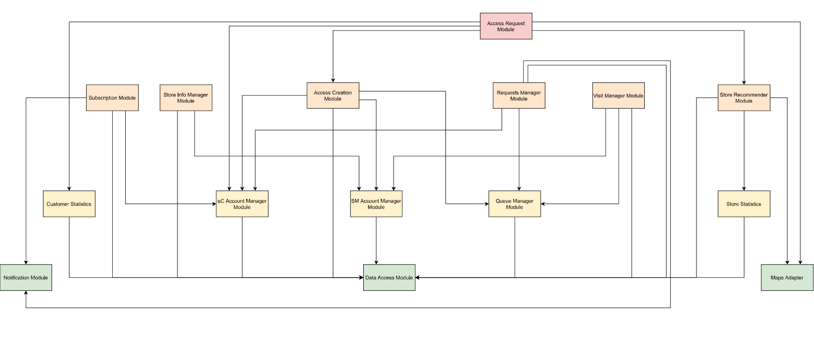
Implementation, integration and test plan
Notes:
In the iit section we decided to proceed with a bottom up by first identifying dependencies among modules

Slide 24
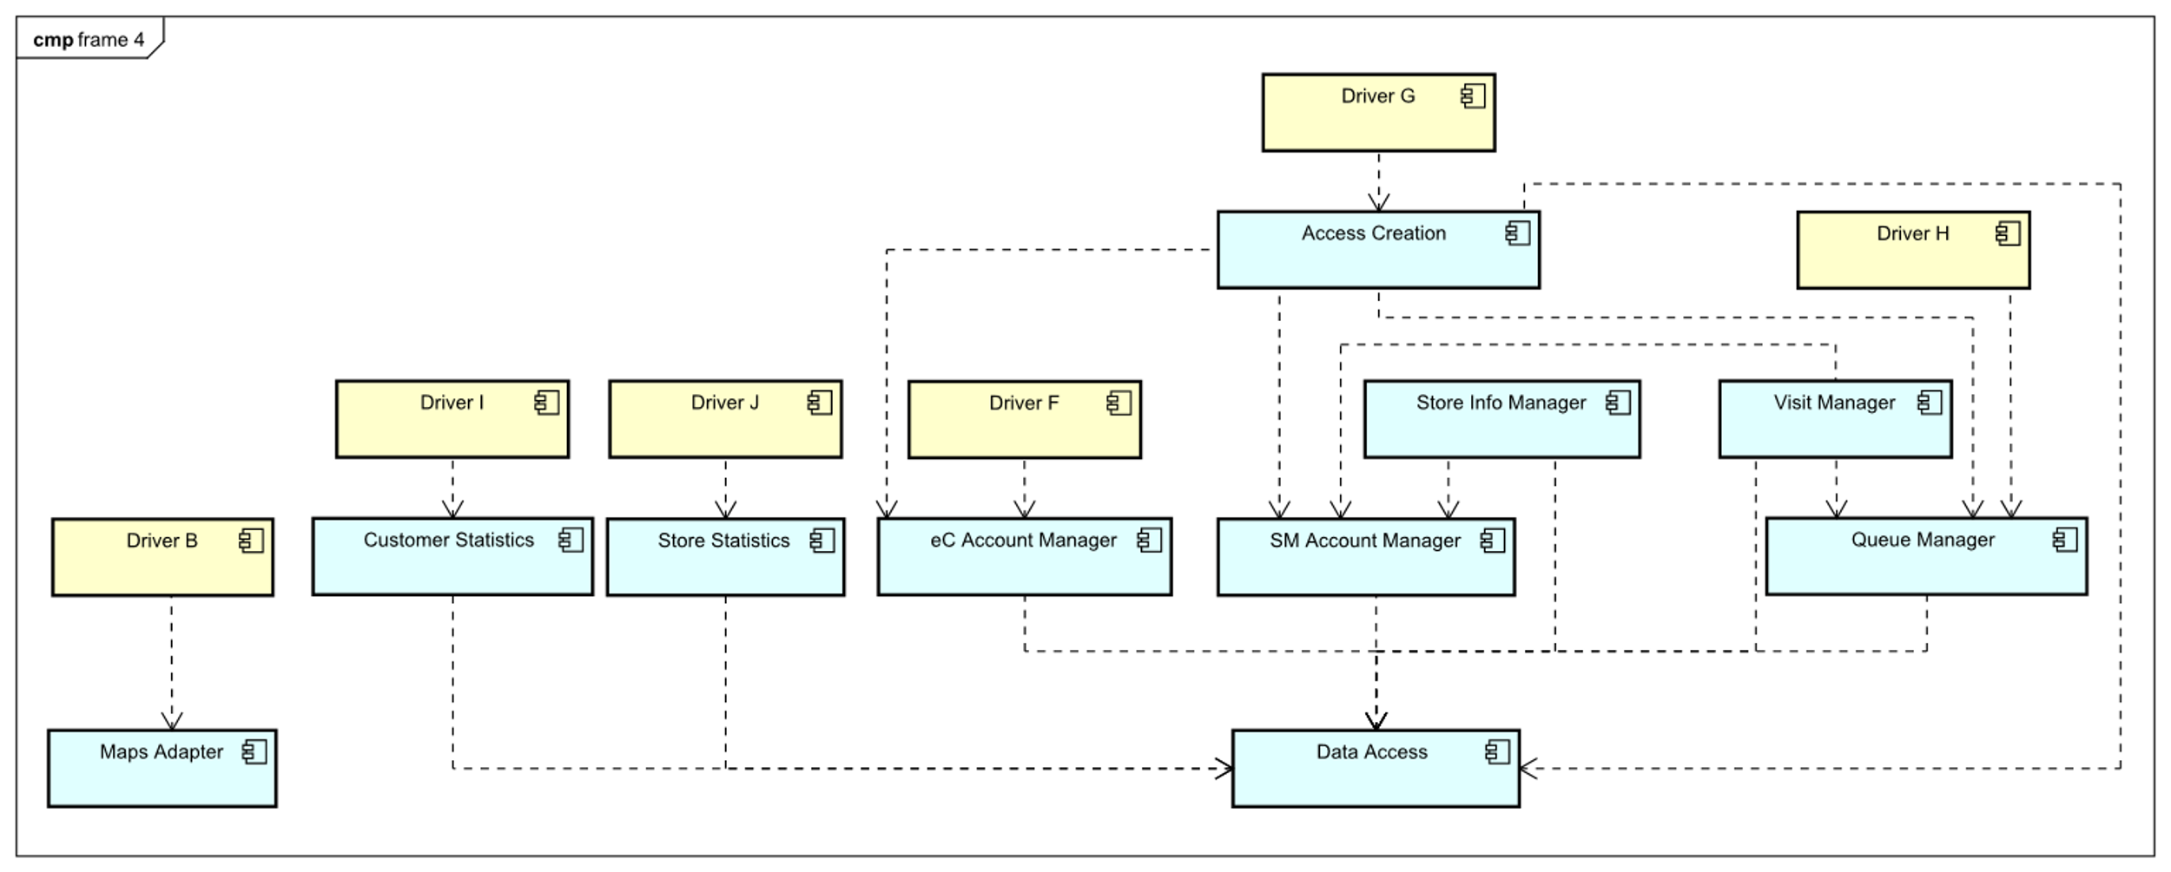
Implementation, integration and test plan
Notes:
The approach chosen allows us to integrate components and test them as soon as they’re available through the use of drivers in order to find issues quickly

Slide 25
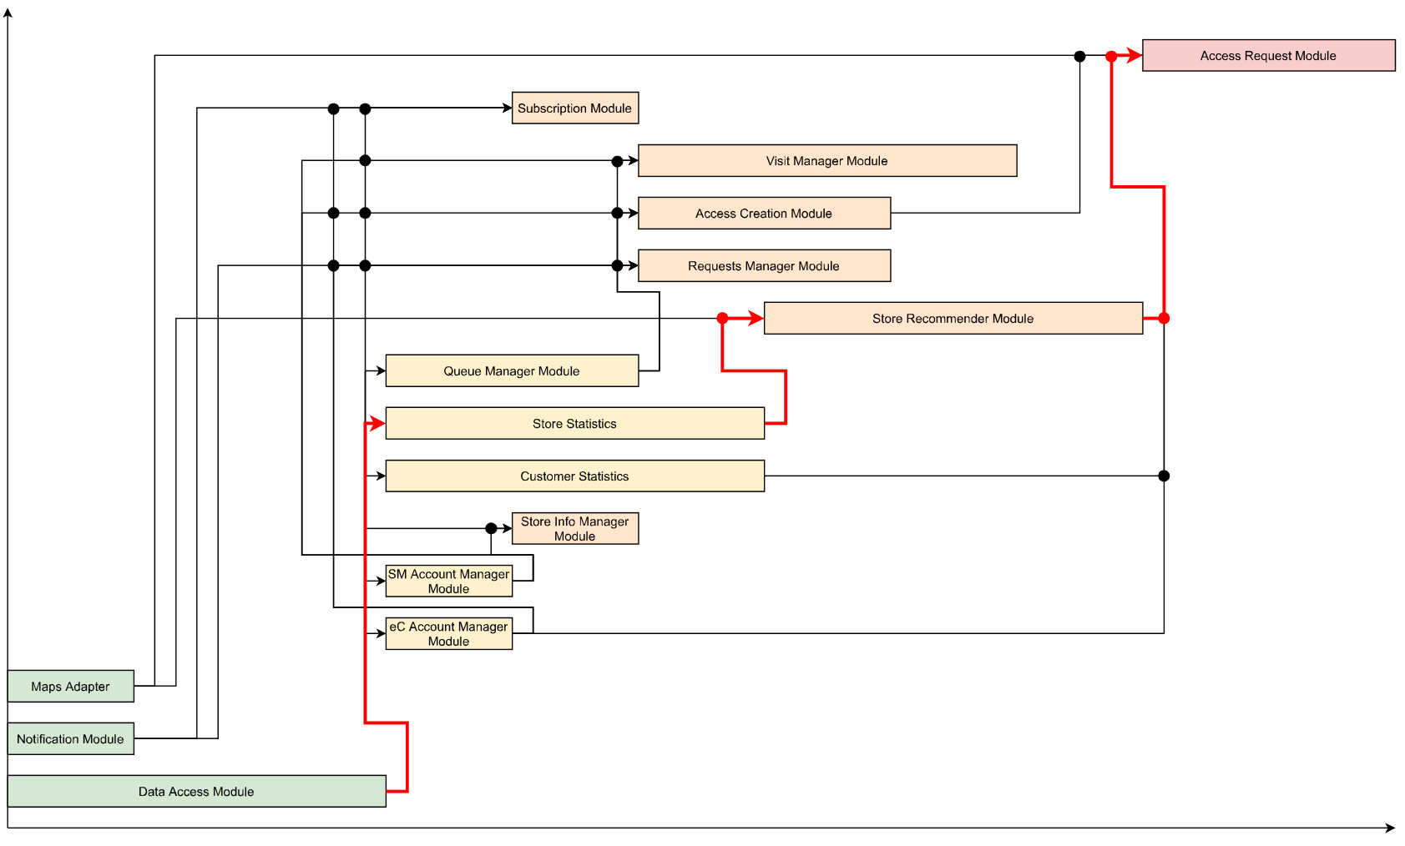
Implementation, integration and test plan
Notes:
We also identified a plan for the parallelization of the development, with the highlighted critical path created by assigning an estimated effort (length) to each module.

Slide 26

Thank you for your attention! Any feedback?

